Slide 1
GESTURE CONTROL
CAR
Prepared by :
Abhijith P Biju
Alan K Reji
Anuvind S
Gokul S Babu
Harischand S Nair
Mohammed Aathif Nizar

Slide 2
CONTENTS
INTRODUCTION
RECEIVER SIDE
Components
Schematic Diagram
TRANSMITTER SIDE
Components
Schematic Diagram
SENSOR
WORKFLOW
APPLICATION
CONCLUSION

Slide 3
INTRODUCTION
Gesture-controlled RC cars, also known as remote-controlled cars, are vehicles that can be operated and controlled using hand gestures or body motions instead of traditional joystick-based controls. These cars leverage advanced sensor technologies and gesture recognition algorithms to interpret human gestures and translate them into vehicle commands.
The application of gesture-controlled RC cars spans across various industries and domains, offering a wide range of benefits and functionalities. In this presentation, we will explore the versatile uses and benefits of gesture-controlled RC cars, highlighting their importance in robotics, entertainment, education, research, and more.

Slide 4
RECIEVER SIDE COMPONENTS
ESP32: https://amzn.to/3EIqdyb
2 - L293D Motor Driver: https://bit.ly/3fbXEtc
16 pin IC Base: https://amzn.to/43GHQsj
4 - BO motor: https://amzn.to/3KKB5Np
4 - Wheels: https://bit.ly/3UEf33n
AMS1117 - 5v Voltage Regulator: https://amzn.to/3yLDAts
5 - 2 pin Pitch Screw Terminal: https://amzn.to/3MS3h3s
Header pins: https://amzn.to/41fKwv8
on/off Switch: https://amzn.to/41beAYQ
2 - 220uf Capacitor 100uf Capacitor 18650 Li-ion Cell: https://amzn.to/3L4H80B
2s 18650 Cell Holder: https://amzn.to/3L67IX8, https://amzn.to/3KHz98m

Slide 5
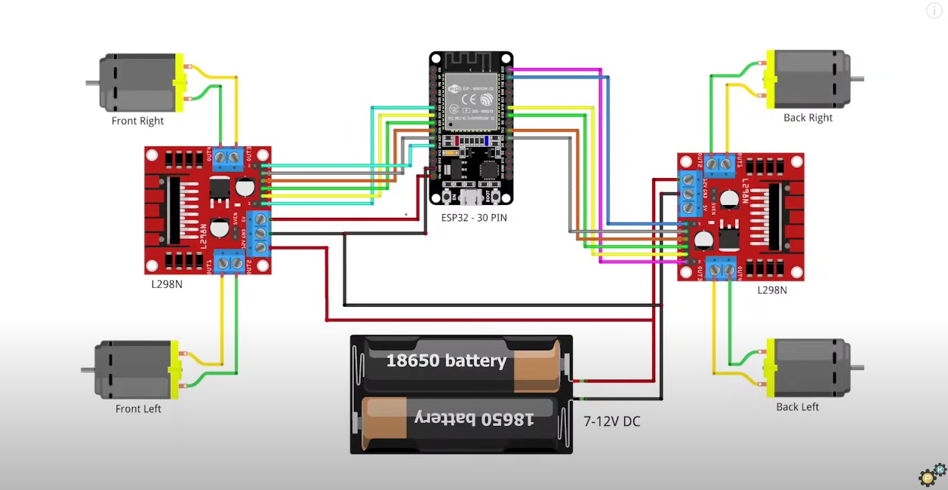

Slide 6
TRANSMITTER SIDE COMPONENTS
ESP32: https://amzn.to/3EIqdyb
MPU6050: https://amzn.to/3T7F61o
Header pins: https://amzn.to/41fKwv8
on/off Switch: https://amzn.to/41beAYQ
18650 Li-ion Cell: https://amzn.to/3L4H80B
1s 18650 Cell Holder: https://amzn.to/41sYyt4

Slide 7
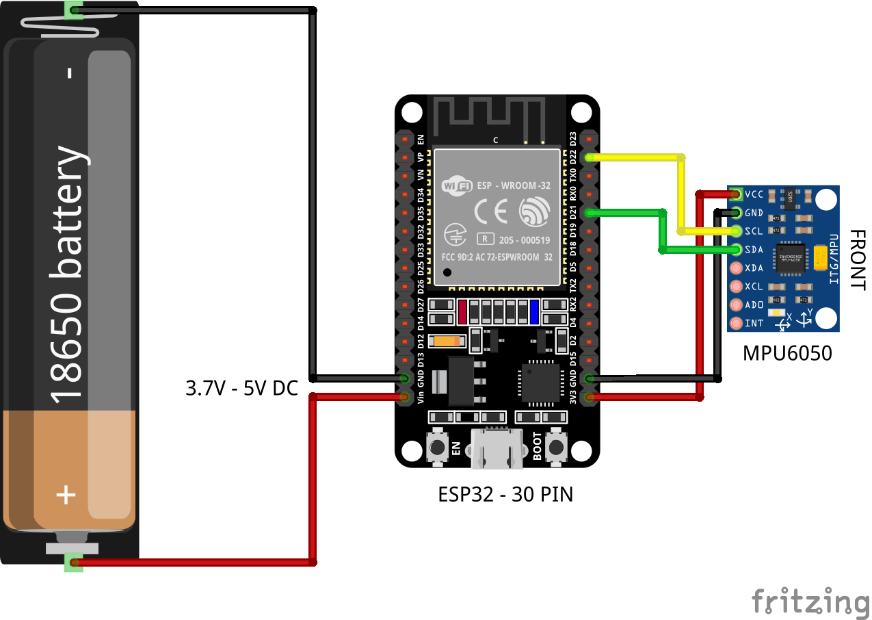

Slide 8
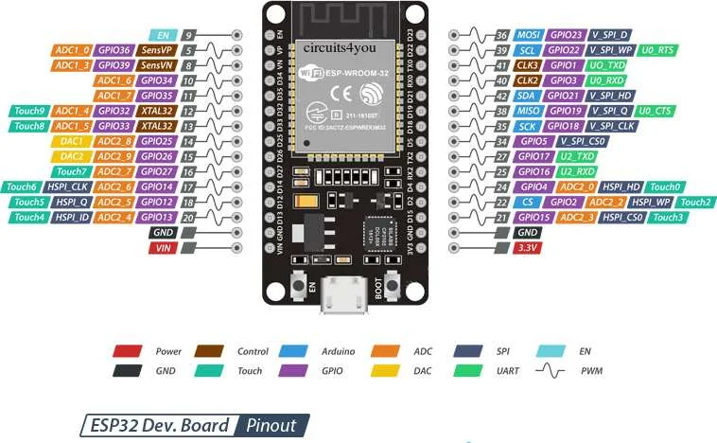
ESP32
The ESP32 has a dual-core processor, which allows for more complex tasks to be handled simultaneously.
The ESP32 comes with built-in Wi-Fi and Bluetooth capabilities, allowing for easy communication with other devices such as smartphones or computers.
The ESP32 is designed to operate efficiently, making it suitable for battery-powered applications like RC cars.
The ESP32 ecosystem offers various libraries and frameworks that simplify the implementation of gesture recognition algorithms.
ESP32 remains relatively affordable compared to other microcontroller options with similar capabilities.

Slide 9
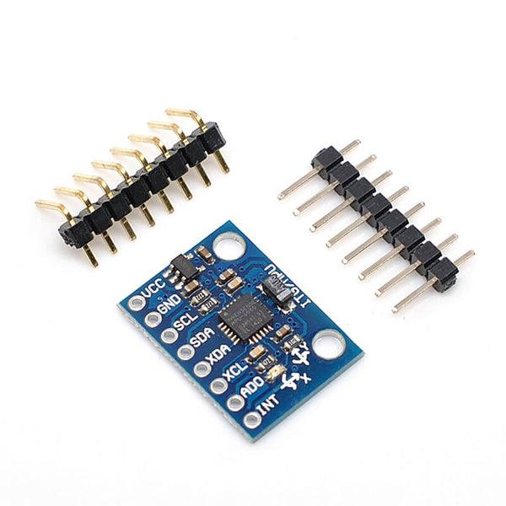
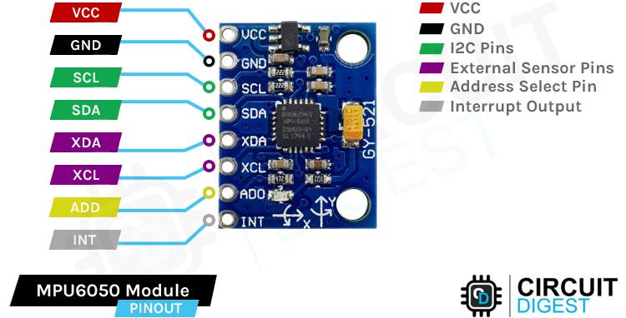
SENSOR USED
The MPU6050 is a compact and versatile integrated circuit that combines a three-axis gyroscope and a three-axis accelerometer.
It accurately measures angular velocity and linear acceleration across X, Y, and Z axes, making it ideal for motion sensing applications.
Equipped with a Digital Motion Processor (DMP), it fuses gyroscope and accelerometer data to correct sensor drift and enhance motion tracking precision.
Communicating via I2C, it integrates seamlessly with microcontrollers, offering low power consumption, a FIFO buffer, motion detection interrupts, and temperature sensing.
Widely used in drones, robotics, IMUs, sports analytics, and IoT devices, the MPU6050 is essential for precise and efficient motion-based tasks.

Slide 10
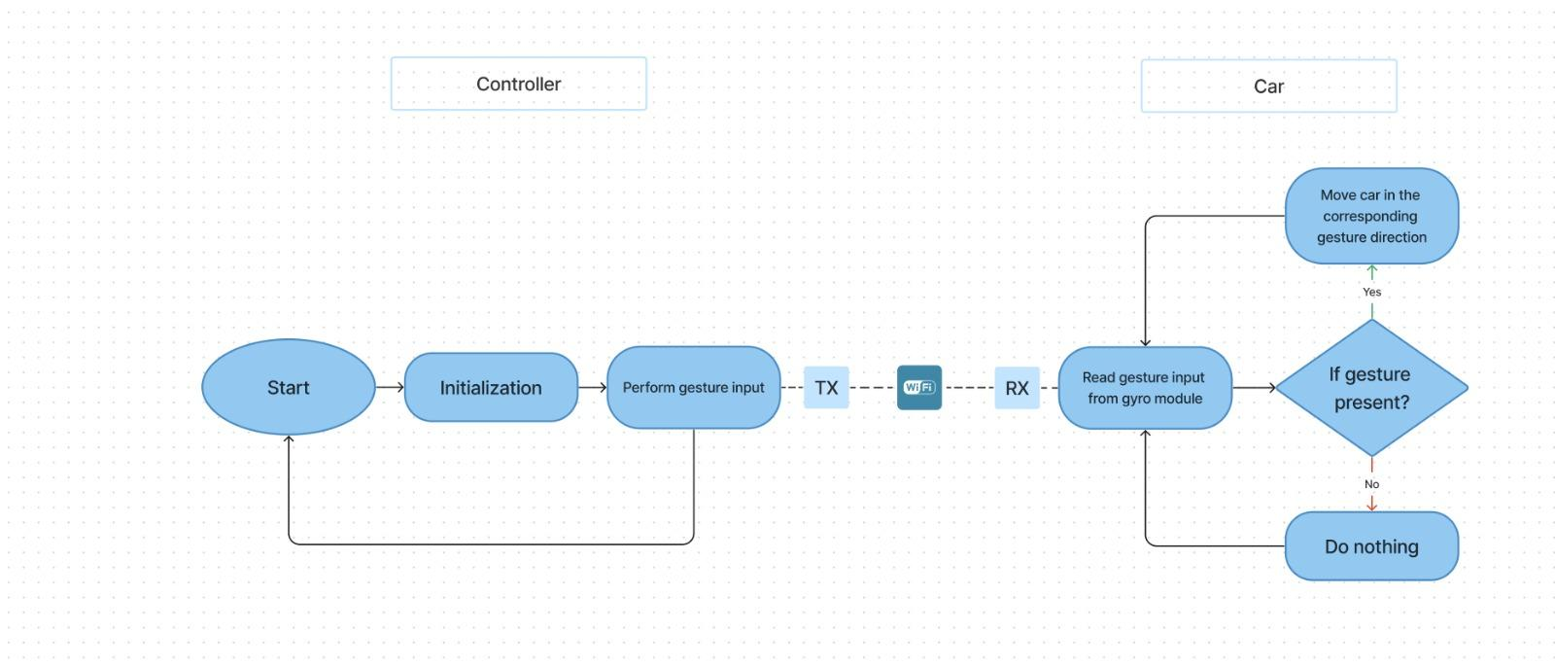
WORKFLOW

Slide 11
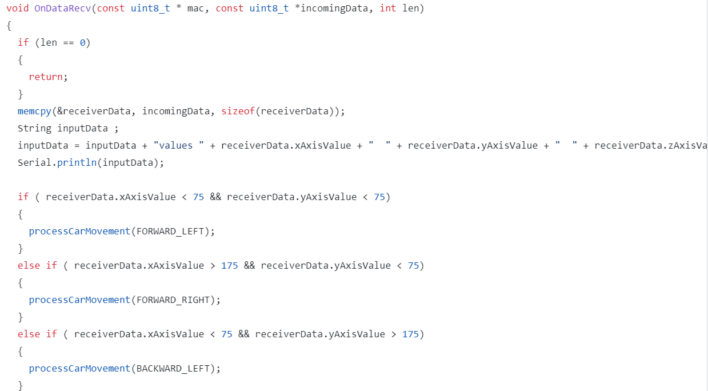
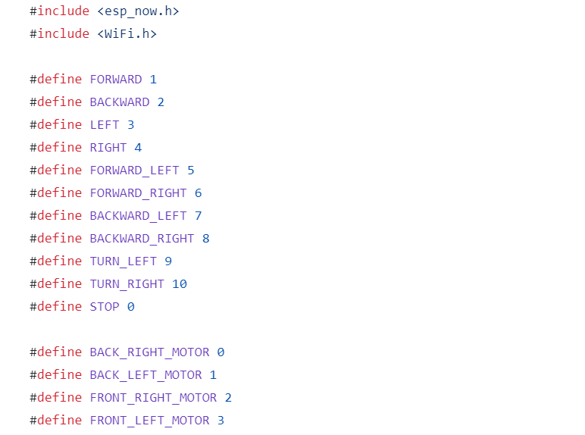
Code Snippets

Slide 12
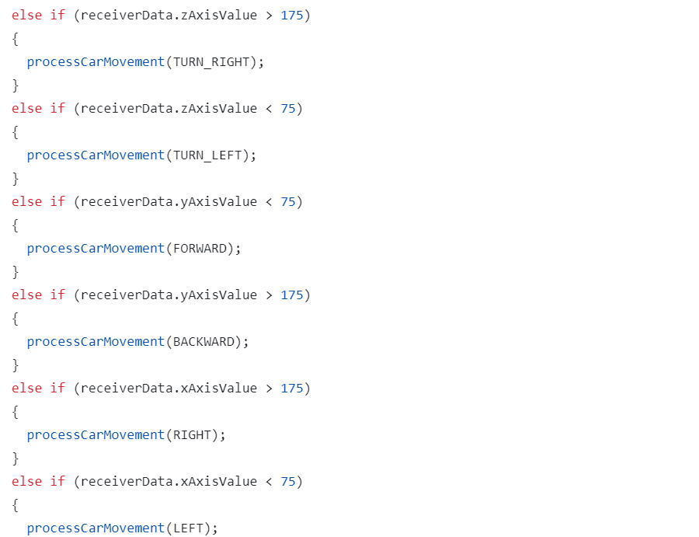
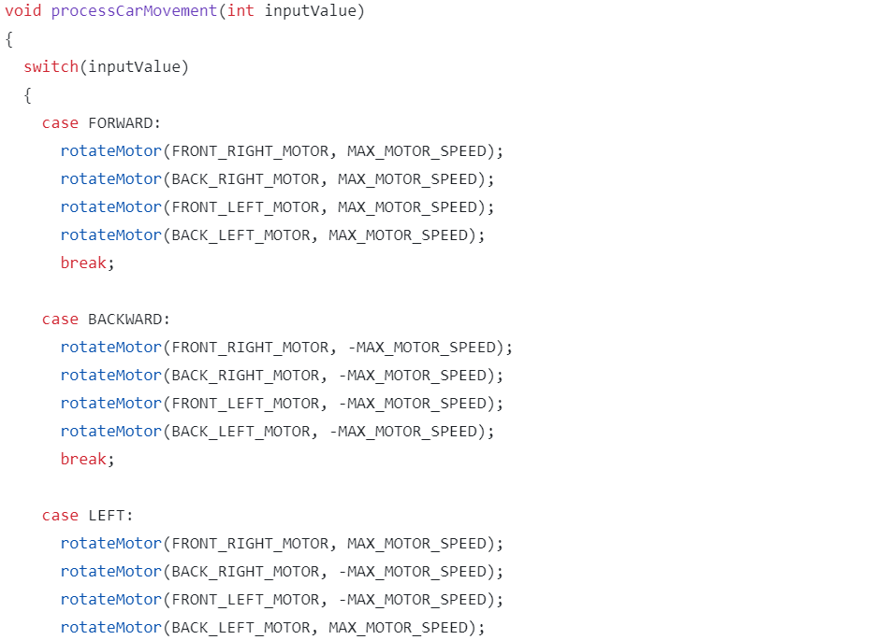

Slide 13
APPLICATIONS
Material Handling in Warehouses
Urban Delivery Services
Search and Rescue Operations
Hospitality Industry
Educations and STEM learning
Security and Surveillance
Health care assistance
Entertainment and Gaming Purpose

Slide 14
CONCLUSION
Gesture-controlled RC cars represent a cutting-edge advancement in interactive vehicle control technology, offering a futuristic alternative to traditional joystick-based systems. By harnessing advanced sensor technologies and sophisticated gesture recognition algorithms, these vehicles empower users to command and navigate them through intuitive hand gestures or body motions. The applications of gesture-controlled RC cars span across various industries and domains, including robotics, entertainment, education, and research.

Slide 15
THANK YOU

